Slide 1
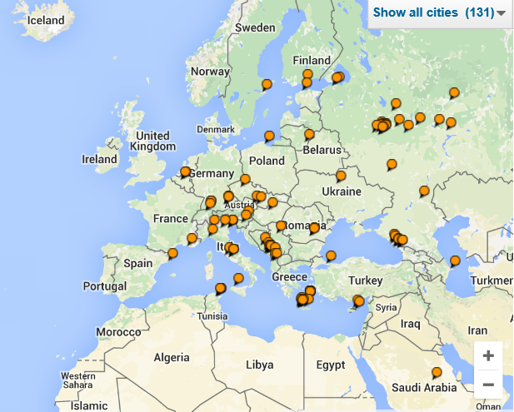
Make you mobile app live with Notification Hub and Tiles
Igor Sychev
Azure/Dev Premier Field Engineer (PFE)
Microsoft

Slide 2
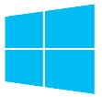
Platform Convergence Journey
Xbox 360
Xbox One
Converged
Operating System kernel
Windows 8
Windows 8.1
Converged
app model
Windows 10
Windows Phone 8.1
Windows Phone 8
Windows Phone 7.5
Windows on Devices
Notes:
Speaker Notes:
First, let us discuss a little bit of history and where do we come from.
----------------------------------------------------------------
Platform convergence has been a journey which ends today with Windows 10.
We started by bringing Internet Explorer to Windows Phone 7.5 and even Xbox 360. With the release of Windows 8, we laid the foundation with the windows kernel, drivers etc. Windows Phone 8 took advantage of this. Xbox One was built on top of Windows 8 and even used the same runtime so developer could write apps in HTML/WinJS the same framework as available on Windows 8.
With the release of Windows Phone 8.1, the runtimes from Windows 8.1 and phone came together as well. Over 90% API convergence and things like Windows Notification Services, sharing contracts, live tiles, etc. started to come together.
Our endpoint Threshold brings together everything, the foundation is the same, kernel, drivers, etc. The application platform is the same and we will go into a little bit more detail later in this presentation.
Background data:
September 15, 2011 - Windows Phone 7.5
October 26, 2012 - Windows 8
October 29, 2012 - Windows Phone 8
October 18, 2013 - Windows 8.1
November 22, 2013 - Xbox One
April 8, 2014 - Windows 8.1 Update
March 26, 2014 - Windows Phone 8.1
Purpose of this slide: Set the historic context that when we say “Threshold” we mean the converged platform.
We have about 1.5 billion devices. That is a lot of devices for developers to target. However, the 1.5 billion devices do not all have the same app model; some are XP, some are Xbox, some are phones, some are tablets, and some are servers. What language or platform do I choose? Microsoft Foundation Classes (MFC), or Windows Presentation Foundation (WPF), or SL or Windows RT.
Nothing shows “One Windows” more than the way our platforms are converging, a journey which ends with Windows “Threshold.”
With the release of Windows 8, we laid the foundation. You sometimes hear this referred to as OneCore.
Windows Phone 8 took advantage of this and Xbox One was built on top of Windows 8.
With the release of Windows Phone 8.1, the Windows RT runtimes from phone and desktop came together. Over 90% API convergence.
Threshold brings everything together, the foundation is the same, kernel, drivers etc. – from computers to phones, to IoT devices.
The application platform is the same across all of these devices. Seems incomplete – kindly elaborate on the context for clarity.
[EDITOR] Shiron
Date formats have been modified for clarity. Please validate if they are correct.
Original:
• 9/15/11 Windows Phone 7.5
• 10/26/12 Windows 8
• 10/29/12 Windows Phone 8
• 10/18/13 Windows 8.1
• 11/22/13 Xbox One
• 4/8/14 Windows 8.1 Update
• 3/26/14 Windows Phone 8.1

Slide 3
One Windows
Desktop SKU
Mobile SKU
Xbox SKU
IoT SKU
IoT headless SKU
Surface Hub SKU
Holographic SKU
PC
Two-in-one
Tablet
Phablet
Phone
Xbox
Band
Raspberry Pi
Surface Hub
HoloLens
Home Automation
Notes:
Stock Keeping Units (SKUs) are the different “marketing” versions and below the corresponding devices.

Slide 4
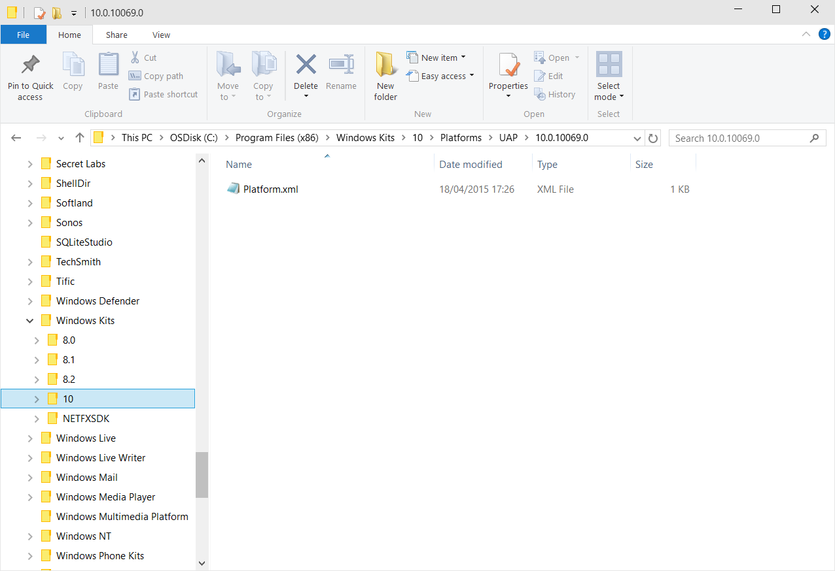
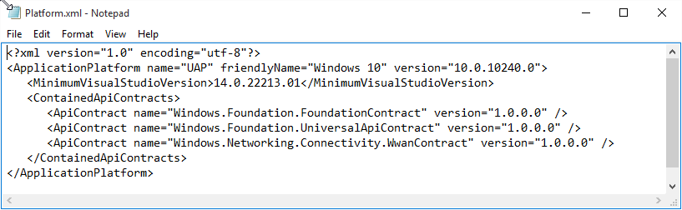
Universal Windows Platform
A single API surface
A guaranteed API surface
The same on all devices
Universal Windows Platform
Windows Core
Desktop
Device
Phone
Device
Xbox
Device
Notes:
Speaker Notes:
TODO: Update with Windows 10 / Microsoft Visual Studio 2015 RTM
Demo: Show where this is stored.
---------------------------------
Go to C:\Program Files (x86)\Windows Kits\10\Platforms\UAP\10.0.10240.0
Click the platform.xml file.
Go to C:\Program Files (x86)\Windows Kits\10\References\ and look for Windows.Foundation.UniversalApiContract and the two other .winmd files.
Open the files in ILspy.
Windows.Foundation.UniversalApiContract is the former Windows RT APIs and new Windows 10 APIs.
[EDITOR] Deepankar Panda (Spectrum Consultants India Pvt):
06 October 2015 Seems ambiguous – Kindly elaborate on the context for clarity.
[EDITOR] Deepankar Panda (Spectrum Consultants India Pvt):
06 October 2015 Seems incomplete – Kindly elaborate on the content for clarity.

Slide 5
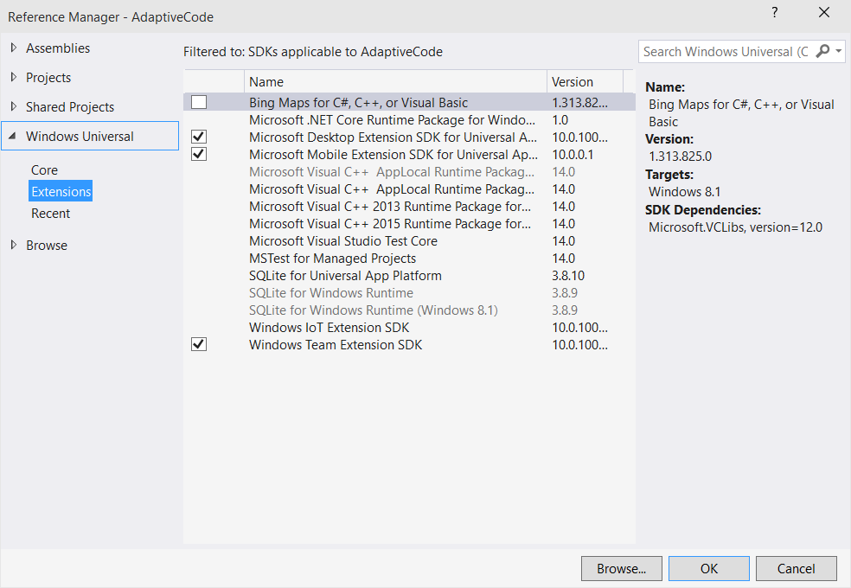
Platform Extensions
Device-specific API
Family-specific capabilities
Compatible across devices
Unique update cadence
Windows App
Desktop
extension
Phone
extension
Xbox
extension
Universal Windows Platform
Windows Core
Desktop
Device
Phone
Device
Xbox
Device
Notes:
TODO: Check the screenshot with Visual Studio 2015.

Slide 6
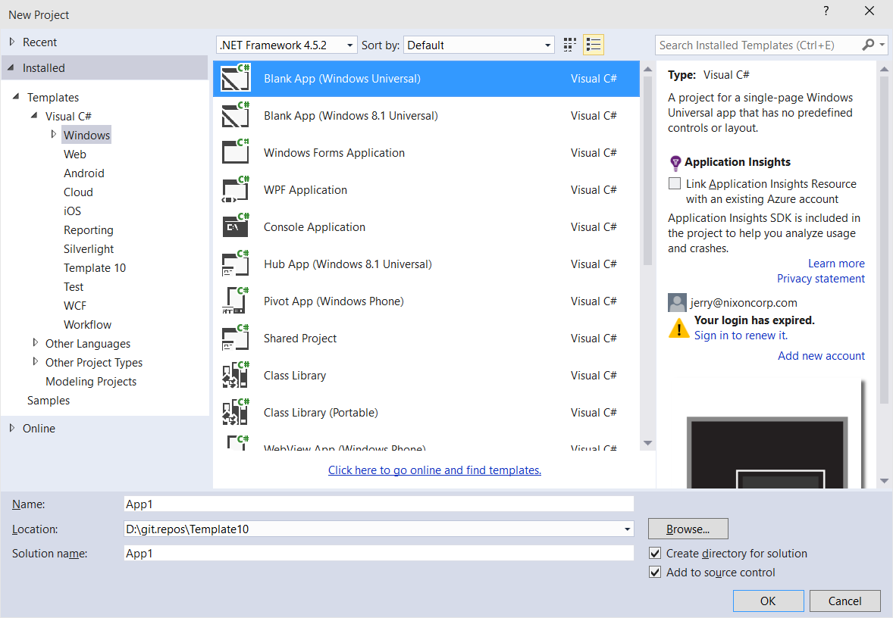
Windows App
A single binary
Running on any device
Testing for capabilities
Adjusting to devices
Windows App
Universal Windows Platform
Windows Core
Desktop
Device
Phone
Device
Xbox
Device
Notes:
TODO: Retake the screenshot with Visual Studio 2015 RTM.

Slide 7
Testing for Capabilities
Windows.Foundation.Metadata.ApiInformation
IsApiContractPresent
IsEnumNamedValuePresent
IsEventPresent
IsMethodPresent
IsPropertyPresent
IsReadOnlyPropertyPresent
IsTypePresent
IsWriteablePropertyPresent
Notes:
These tests are done at runtime with the ApiInformation methods.
All types are associated to “Contracts” (not the same as Share “contract”). These contracts are a consistent unit of features that are assumed to be all implemented or not implemented at all. The UWP and the SDK extensions are implementing contracts (see slide 17 to know where these lists of contracts are defined in the SDK).
This association type/contract is done via the ContractVersionAttribute
[ContractVersion(typeof(DevicesLowLevelContract), 65536u), …] public sealed class GpioController : IGpioController
Note: Use IsApiContractPresent when you need to use several types of the same contract to avoid many calls to IsTypePresent.

Slide 8
Test Capabilities at Runtime
Use Adaptive Code to light-up your app on specific devices
var api = "Windows.Phone.UI.Input.HardwareButtons";
if (Windows.Foundation.Metadata.ApiInformation.IsTypePresent(api))
{
Windows.Phone.UI.Input.HardwareButtons.CameraPressed += CameraButtonPressed;
}
Notes:
Do not use typeof(Windows.Phone.UI.Input.HardwareButtons).ToString() that “Windows.Phone.UI.Input.HardwareButtons” because it would raise an exception on a platform where the API is not implemented.

Slide 9
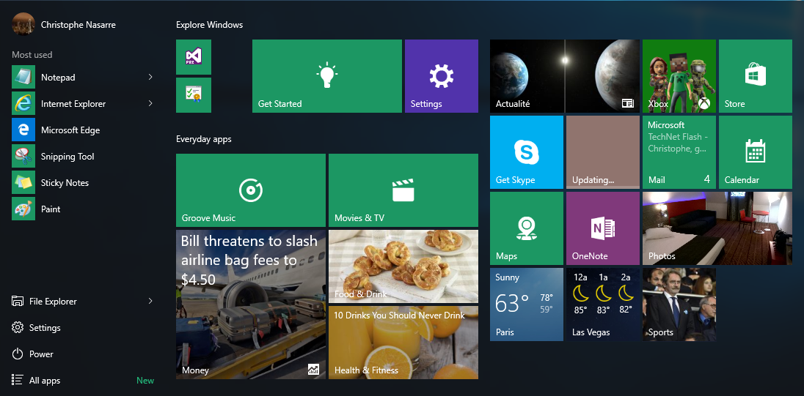
Tiles = Shell to View and Start Apps
Notes:
Glance (consume) Quickly review new information and engage with apps before launching them.
Live tiles introduced the concept of displaying updates and real-time information from their apps on the user's Start screen. Elevating app content into the tile, gives users more information and helps them decide whether or not to launch the app. It is what makes a tile unique, rich, personal, and interesting.
Go (launch) Start by its very nature is where you go to begin a task. At its most basic, the tile is the doorway into the app by launching it.
NOTE: mention the notion of secondary tiles (prepare a secondary tile for weather or money ($MSFT stock for example)

Slide 10
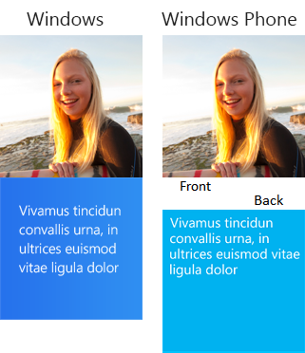
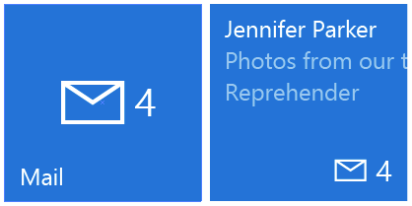
Tile Templates
Legacy Templates If there is a template that already meets your needs perfectly, feel free to use the legacy template catalog. There are over 80 different templates available for use
Adaptive Tile Templates (Windows App) The adaptive tile template is our most flexible tile we have ever had. This template allows you to put the content you want on the tiles, how you want it, and have it work across all of Windows phone, tablet, and computer devices
Notes:
Legacy Windows 8.1 > Static catalog with differences between Windows Phone and Windows computer
Windows 10 = There is no longer any difference between Windows Phone and Windows computer with adaptive tile templates
Except large tile is not available on Windows Phone from now.
DEMO: show the legacy tile template catalog - https://msdn.microsoft.com/en-us/library/windows/apps/hh761491.aspx
https://msdn.microsoft.com/EN-US/library/windows/apps/windows.ui.notifications.tiletemplatetype.aspx
[EDITOR] Deepankar Panda (Spectrum Consultants India Pvt):
12 October 2015 Kindly validate the change. Original: “Legacy = 8.1 > static catalog with differences between Phone and Win”

Slide 11
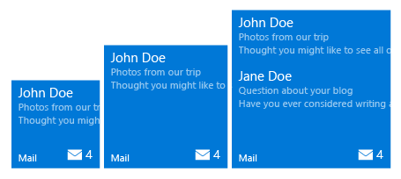
Adaptive Tile Template
Content adapts with the tile The new adaptive tile template works similarly to universal app patterns by allowing your content to adapt depending on the devices screen density. As you design your tiles, it is important to keep in mind how you want your content to adapt to the tiles size on screens of different densities
XML Sample 1
<tile>
<visual>
<binding template="TileMedium">
<group>
<subgroup>
<text hint-style="subtitle">John Doe</text>
<text hint-style="subtle">Photos from our trip</text>
<text hint-style="subtle">Thought you might like to see all of</text>
</subgroup>
</group>
<group>
<subgroup>
<text hint-style="subtitle">Jane Doe</text>
<text hint-style="subtle">Questions about your blog</text>
<text hint-style="subtle">Have you ever considered writing a</text>
</subgroup>
</group>
</binding>
</visual>
</tile>
Content adjusts to screen density?
Min. Med Size
Max Med. Size
Notes:
Only set the tile size once, but as you can see there are different ‘Medium’ tiles as the screen density changes.
Pick pre-defined style, but it is passed as a ‘hint’ to the device, which says to the device if you support this, do it, if not, do what makes sense on this device family.
Groups means different things – If you have a group of things, in the above case, an email sender and body preview, do not show them as separate unless there is space to do so; show/hide information in the same group.
They also may be thought of as columns, and if things do not fit, they just do not appear.

Slide 12
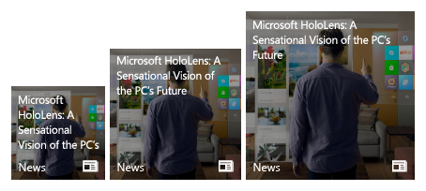
Adaptive Tile Template (continued)
Content adapts with the tile The new adaptive tile template works similarly to universal app patterns by allowing your content to adapt depending on the devices screen density. As you design your tiles, it is important to keep in mind how you want your content to adapt to the tiles size on screens of different densities
Min. Med Size
Max Med. Size
XML Sample 2
<tile>
<visual>
<binding template="TileMedium">
<text hint-wrap=“true">Microsoft HoloLens: A Sensational Vision of the computer’s Future
</text>
</binding>
</visual>
</tile>
Notes:
Multiple images can be added to a tile.
A call directly to the internet to get the tile photo in Windows 10.
You can now wrap text with a single line.

Slide 13
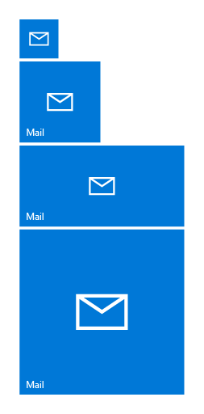

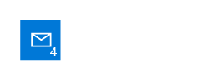
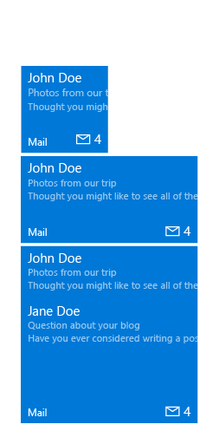
Adaptive Tile States
TileSmall
TileMedium
TileWide
TileLarge
Basic State The default, simplest state of your tile. This state highlights the app’s branding elements to make it clear what the app is
Semi-Live State This state allows you to display a badge notification on your tile to indicate a change in your app (for example, new, status, etc.)
Live State This state allows you to provide timely, relevant content through a notification so the user can make a more informed decision about launching your app
Notes:
Live is really the cool part of using Windows.
Three states:
Basic = When the app is installed using static assets
Semi-live = Badge to update the information
Live = Full fledge text and image

Slide 14
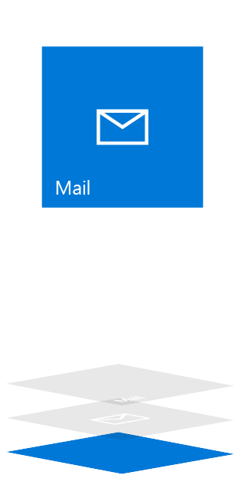
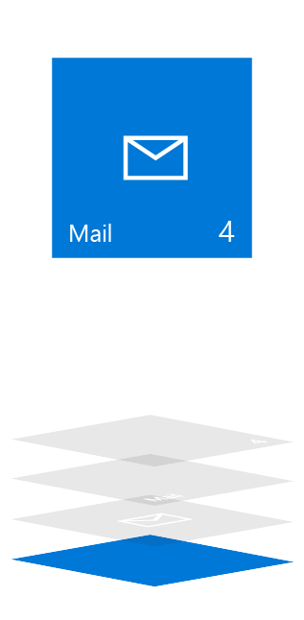
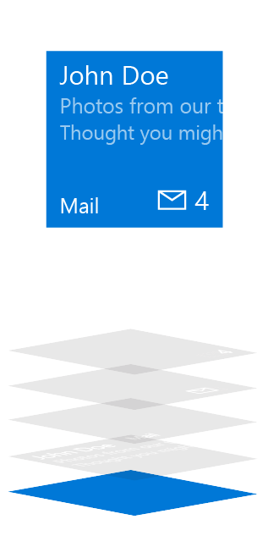
Adaptive Tile Elements and Composition
Basic State
Semi-Live State
Live State
Plate
Plate
Plate
Content
App Logo (Square150x150Logo)
App Logo (Square150x150Logo)
App Icon (Square44x44Logo)
Badge
Badge
Short Name
Short Name
Short Name
Badge
Badge
App Icon (Square44x44Logo)
Short Name
Short Name
Short Name
App Logo (Square150x150Logo)
App Logo (Square150x150Logo)
Content
Plate
Plate
Plate
Notes:
Basic: From the manifest
Semi Live has a live badge, for displaying emails in this case. It could also be missed calls, current temperature, etc.
Live State adds the content layer that adds much of the functionality available to developers.

Slide 15
Demo: Adaptive Layout Tile
Notes:
The demo app is no more working → need to install it from the Store: https://www.microsoft.com/en-us/store/apps/notifications-visualizer/9nblggh5xsl1
Speaker Notes:
TODO: Check demo done at 16:12 in //Build/2-762
Use the Tile Template Visualizer
Select a payload from the combo and “Pin tile to Start” four times to see the result on the Start menu for the four sizes.
Change the Device from the combo on the upper-right of the page and also the density.
Calendar.xml
Different templates (TileSmall/TileMedium/…)
Text with hint-wrap and hint-style
Branding
Mail.xml
Groups that are shown or hidden together.
Example: Email from Steve Bosniak appears on the large tile but not on the Wide.
Weather.xml
Images as background
Columns are obtained by groups and subgroups.
Hipstame.xml
More complicated with placement for image
If Tile Template Visualizer does not work, see: Adaptive tiles schema - https://msdn.microsoft.com/en-us/library/windows/apps/xaml/mt186446.aspx
and http://blogs.msdn.com/b/tiles_and_toasts/archive/2015/06/30/adaptive-tile-templates-schema-and-documentation.aspx

Slide 16
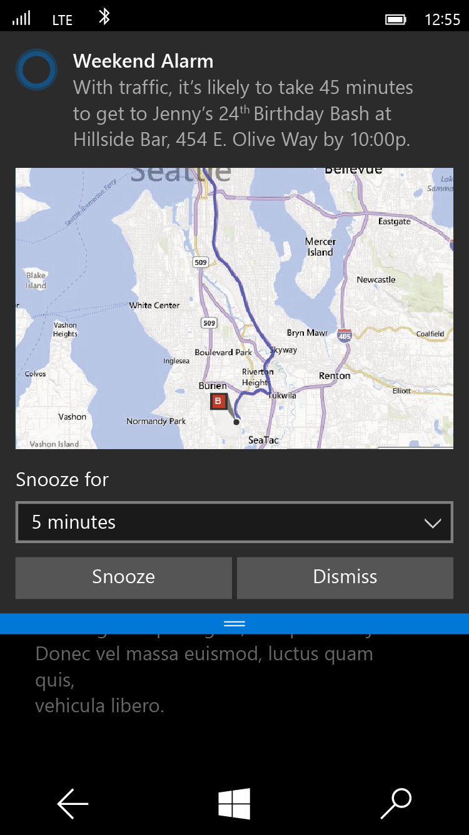
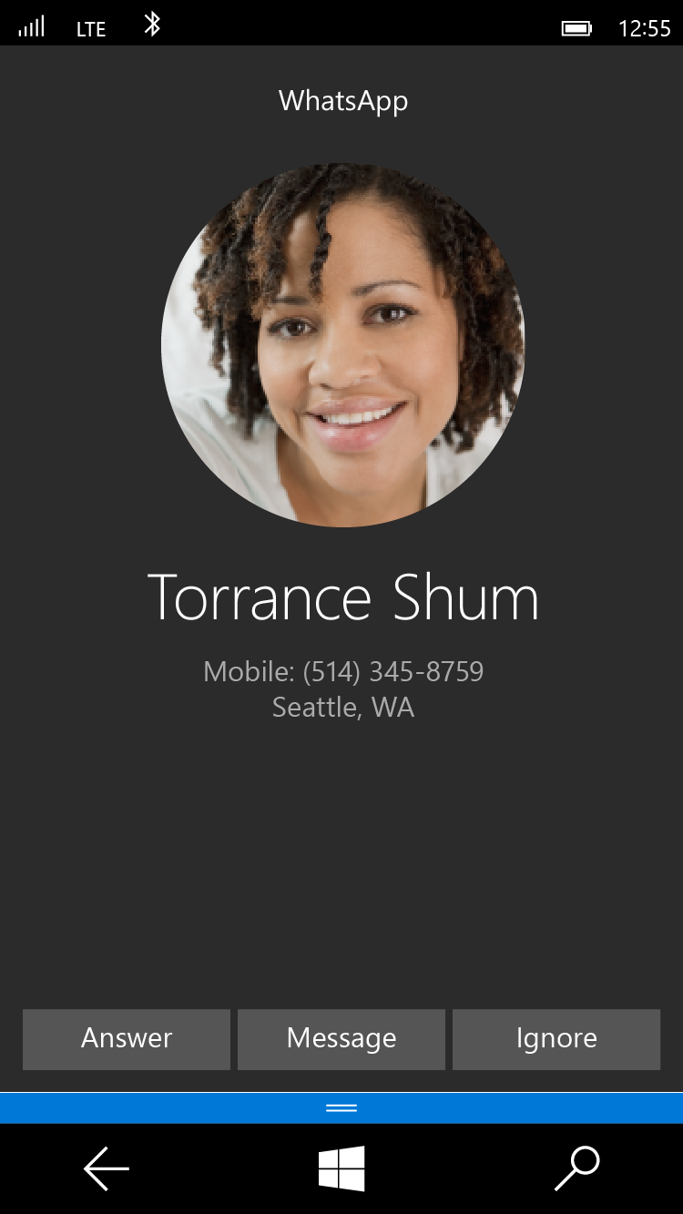
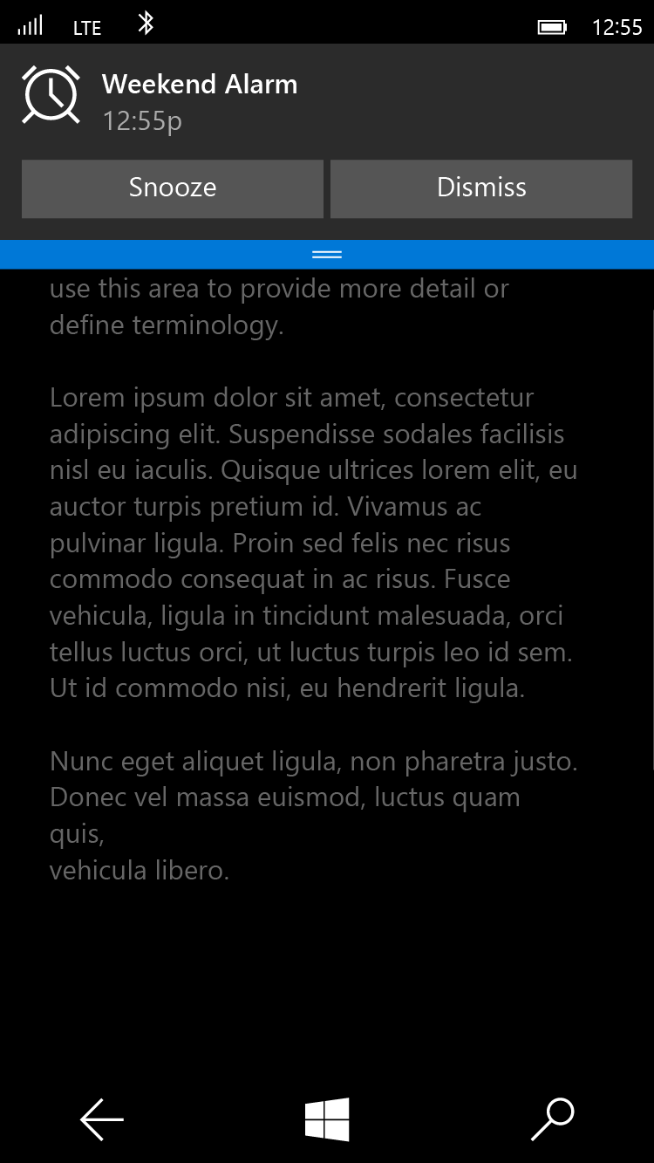
Adaptive Toast Scenarios
Alarm
<toast scenario=“alarm”...>
Reminder
<toast scenario=“reminder”...>
Incoming Call
<toast scenario=“incomingCall”...>
Notes:
An Alarm is a special scheduled toast that system knows how to make, but you can customize it.
Reminder is built off of an interaction.
Incoming call is really a full-screen toast experience, which is what you would probably want for an incoming call.
On desktop maybe it does not take up the whole screen.

Slide 17
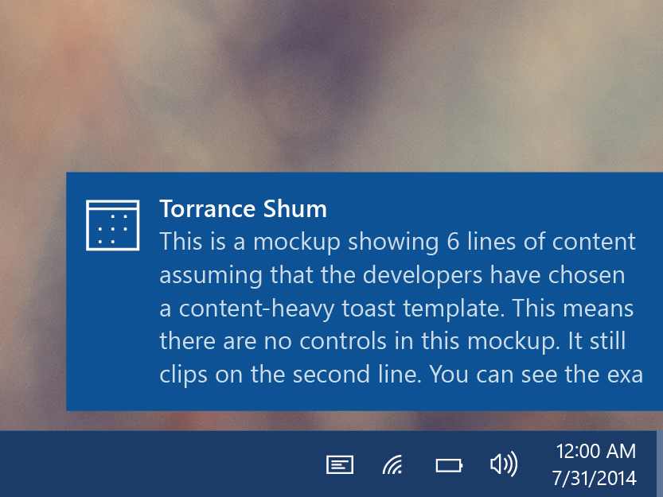
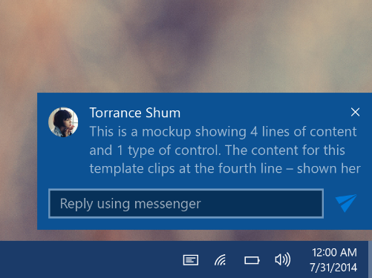
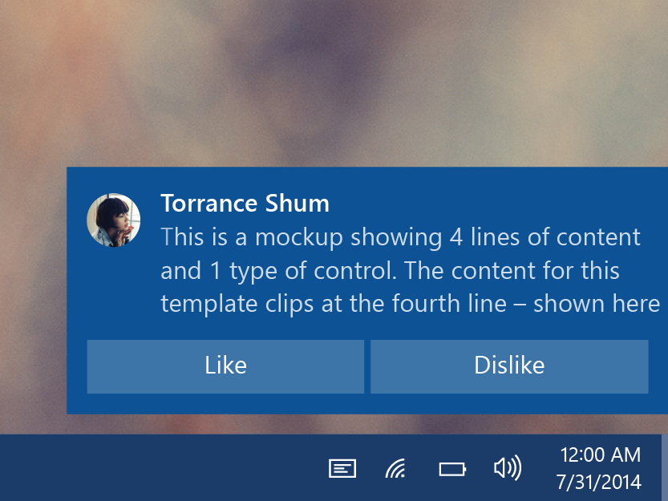
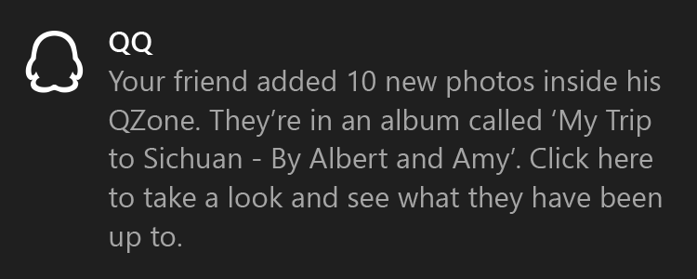
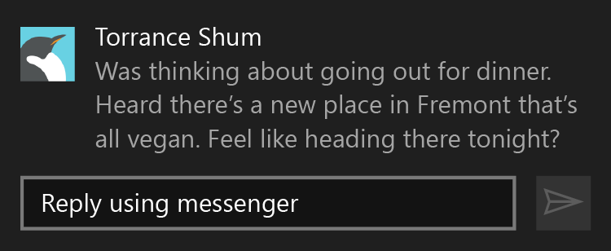
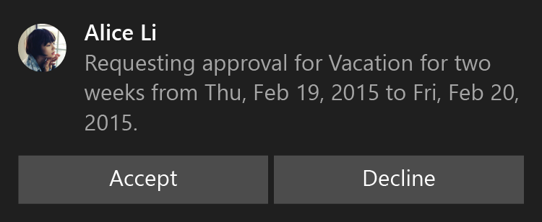
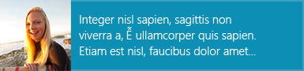
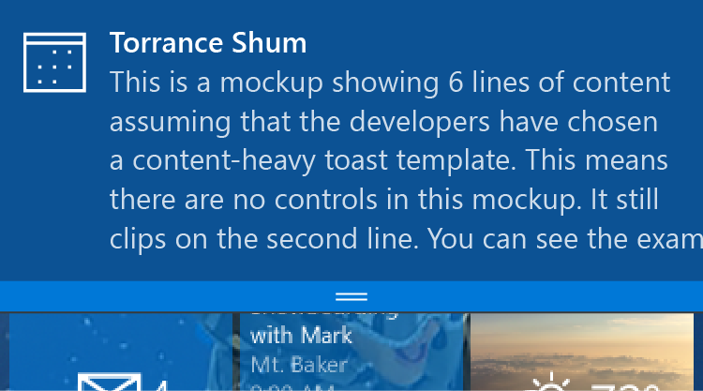
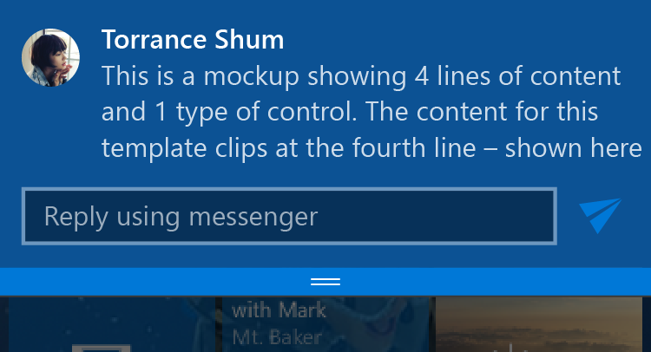
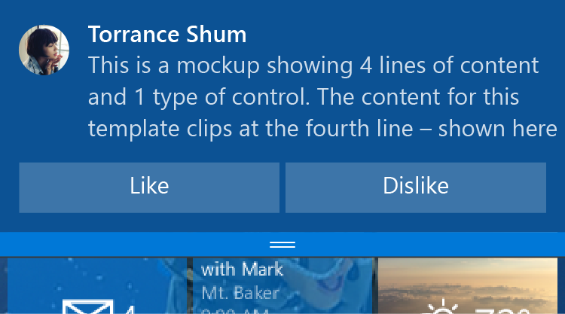
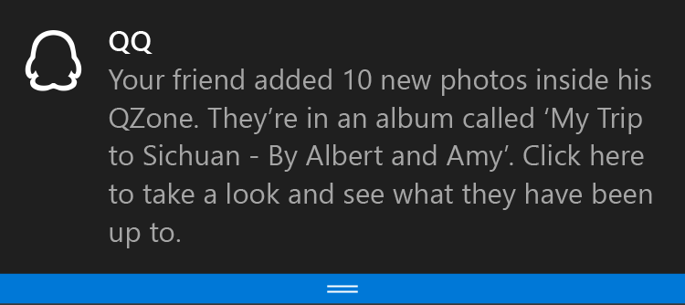
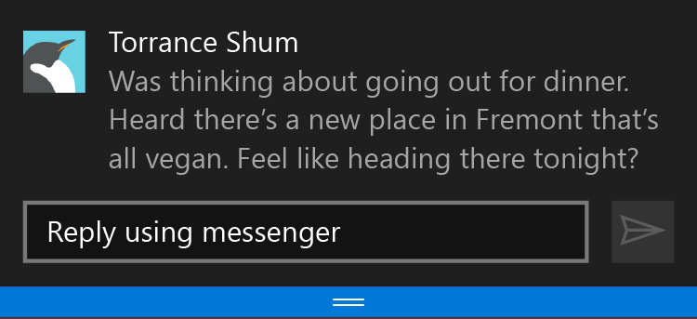
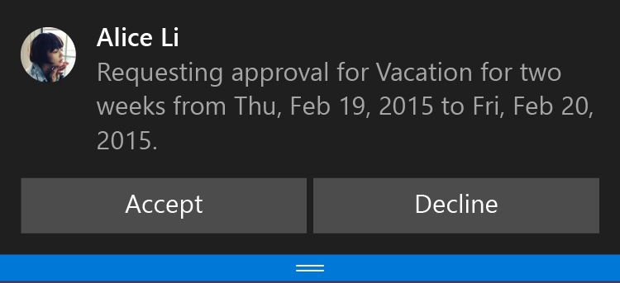
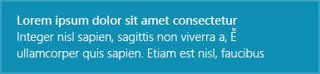
Toast Templates
Legacy Templates If there is a template that already meets your needs perfectly, feel free to use the legacy template catalog. There are eight different templates available for use and previously Windows only template features, like inline images, are now fully working on Windows Phone.
Adaptive and Interactive Toast Template (Windows App) The adaptive toast template is our most flexible toast we have ever had. This template allows you to put the content you want on the toast, how you want it, and have it work across all of Windows phone, tablet, and computers. It allows you to add interactivity to quickly reply to a message, accept an invite, like something on a social network, or snooze an alarm.
Desktop
Mobile
Notes:
Similar as the adaptive tiles, there are adaptive toasts.
Legacy Templates If there is a template that already meets your needs perfectly, feel free to use the legacy template catalog. There are eight different templates available for use and previously Windows only template features, like inline images, are now fully working on Windows Phone.
Adaptive and Interactive Toast Template (Windows App) The adaptive toast template is our most flexible toast we have ever had. This template allows you to put the content you want on the toast, how you want it, and have it work across all of Windows phone, tablet, and computers. It allows you to add interactivity to quickly reply to a message, accept an invite, like something on a social network, or snooze an alarm.
[EDITOR] Deepankar Panda (Spectrum Consultants India Pvt):
12 October 2015 The content is same as on the slide section – kindly validate whether to delete or retain this piece of repeated content.

Slide 18
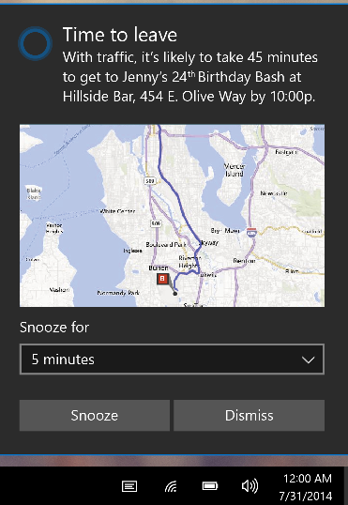
Adaptive Toast Template (continued)
Content adapts with the toast The new adaptive toast template works similarly to universal app patterns by allowing your content to adapt depending on the toast’s size and state. As you design your toasts, it is important to keep in mind how you want your content to adapt to the toasts size
XML Sample 2
<toast>
<visual>
<binding template=“ToastGeneric”>
<text>Time to leave</text>
<text>With traffic…</text>
<image placement=“inline” src=“map.png” />
</binding>
</visual>
<actions hint-systemCommands=“SnoozeAndDismiss” />
</toast>
Want actions?
Notes:
Note how the combo box content is added and in actions, how hint-inputID is set to snoozeTime.

Slide 19
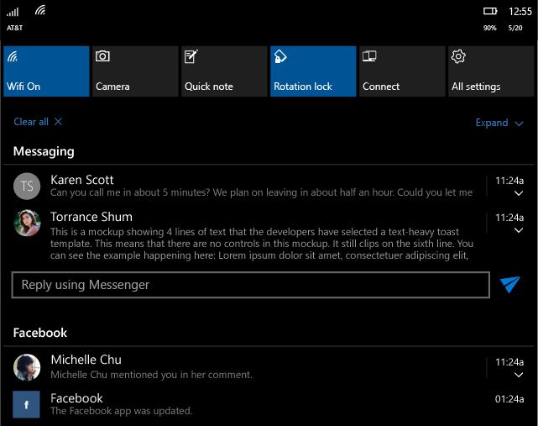
Adaptive Toast Template (continued)
Content adapts with the toast The new adaptive toast template works similarly to universal app patterns by allowing your content to adapt depending on the toast’s size and state. As you design your toasts, it is important to keep in mind how you want your content to adapt to the toasts size
XML Sample 3
<toast>
<visual>
<binding template=“ToastGeneric”>
<text>Torrance Shum</text>
<text>This is…</text>
<image placement=“appLogoOverride” src=“Torrance.png” />
</binding>
</visual>
<actions>
<input id=“1" type=“text“ />
<action activationType=“background" arguments=“quickReply"
hint-inputId=“1" content="" imageUri=“send.png” />
</actions>
</toast>
More interactivity!
Notes:
Note how you can add actions to interactive toasts.

Slide 20
Demo
Adaptive and Interactive Toasts
Notes:
Use the Notification SDK sample and pick the Toast.
First check the adaptive templates: different ways to have images in a toast.
Go to Actions > input text > retrieving arguments: how to pass parameters back to the application Note: TODO 1: This entry point is executed when the user clicks the toast notification.
Go to Activation type > protocol: Able to activate any App that implements a custom protocol.
Scenario and Audio: Show the different sound toasts.
TOAST CAPABLE – killed it with fire
INPUT BOX - Button to pop toast with a text input box.
Enter some text and click the submit button.
Show the text that was entered on the apps tile.
SCENARIO - Button to pop toast for alarm/reminder using a scenario.
Click the snooze button which shows the background task launching and rescheduling the notification.
PROTOCOL LAUNCH – Button to pop a toast to launch a webpage.
TOAST NOTIFICATION HISTORY CHANGED TRIGGER - Button to pop a simple multiline toast that can be expanded.
Click the button multiple times to get several toasts in action center. Note: At least click the button three times.
Update the tile with the count of toasts in action center and show the tile to the audience.
Swipe away a single toast and show the count go down by one.
Swipe away the rest of the toasts all at once and watch the count disappear.
[EDITOR] Deepankar Panda (Spectrum Consultants India Pvt):
12 October 2015 Kindly explain the “killed with fire” phrase with technical terms for better understanding.
[EDITOR] Deepankar Panda (Spectrum Consultants India Pvt):
12 October 2015 Kindly specify what text to be entered for clarity.

Slide 21
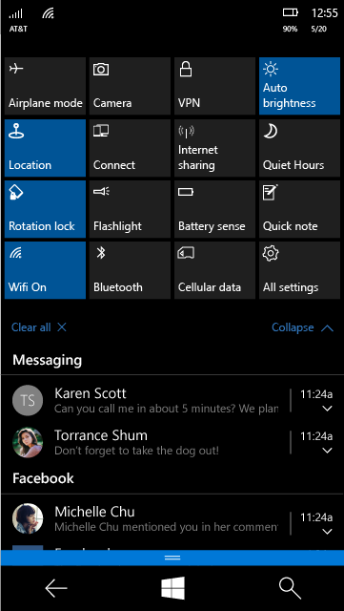
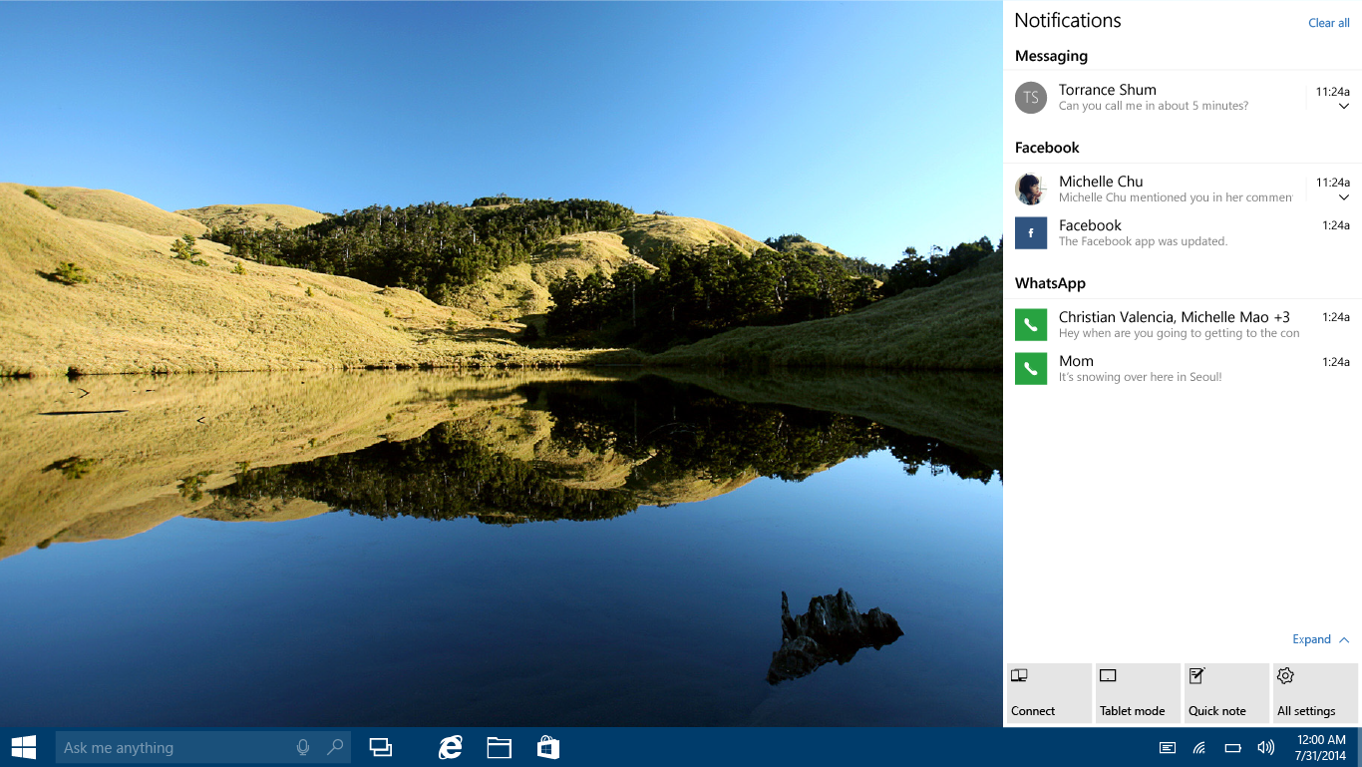
Action Center and Quick Actions
Notes:
Comes from Windows Phone 8.1.
Demo: Show the Action Center in Windows 10.
Click the bubble icon.
Show the Expand at the lower right.
Show the quick action button.
Show the list of notifications and click to start an application.

Slide 22
Action Center – User Experience
20 Notifications per app
Persistent notifications for seven days (or shorter)
Users can:
“Chase” (tap) a notification (removes it from the action center)
Remove a group of notifications
Remove all notifications
Notes:
Note: You can change the notification lifetime by code.

Slide 23
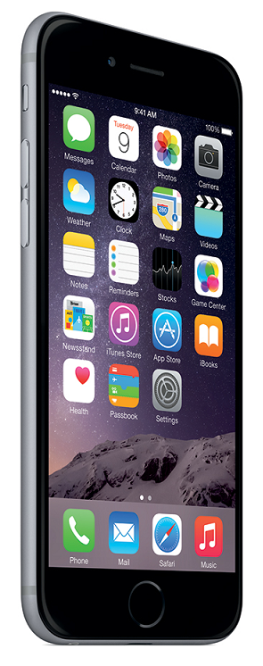
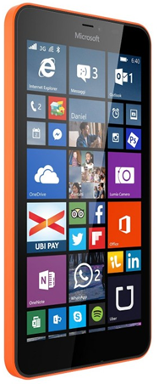
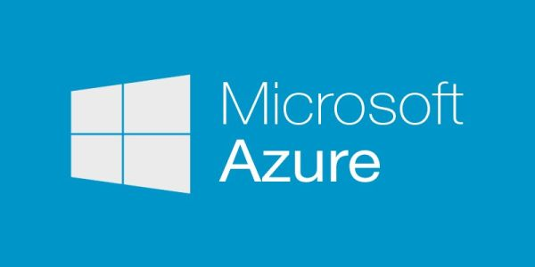
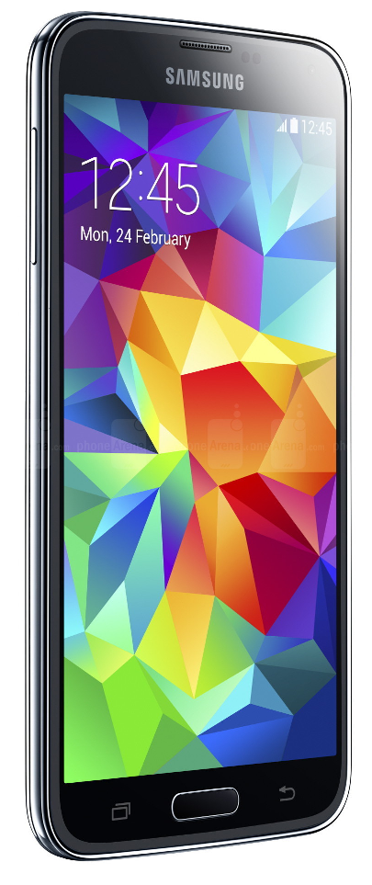
Notification Hub. From Any Back-End to All Mobile Platforms
Apple
Notification Hub
MPNS
Your
application
GCM
Notes:
Push information to single users or millions at a time
Details
Azure Notification Hubs provide an easy-to-use infrastructure that enables you to send mobile push notifications from any backend (in the cloud or on-premises) to any mobile platform.
With Notification Hubs you can easily send cross-platform, personalized push notifications, abstracting the details of the different platform notification systems (PNSs). With a single API call, you can target individual users or entire audience segments containing millions of users, across all their devices.
For more information on Notification Hubs, see: https://msdn.microsoft.com/en-us/library/azure/jj927170.aspx

Slide 24
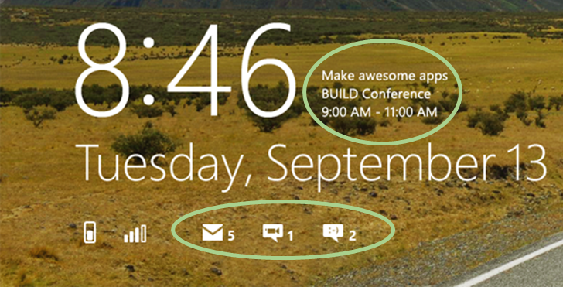
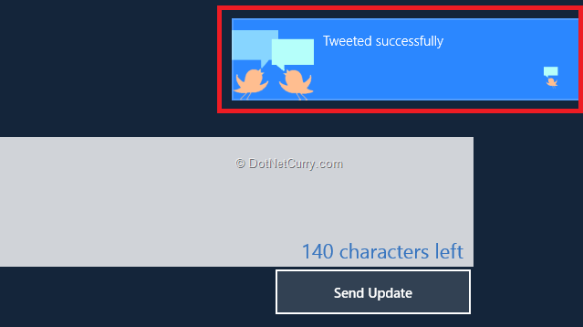
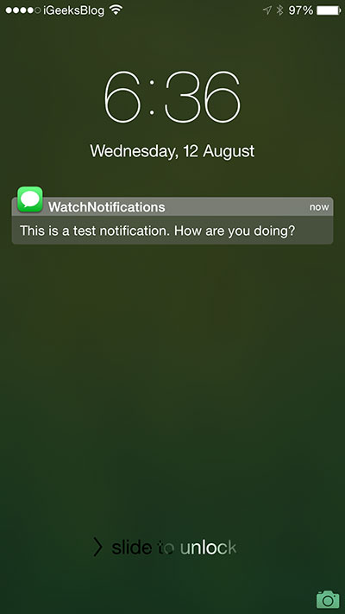
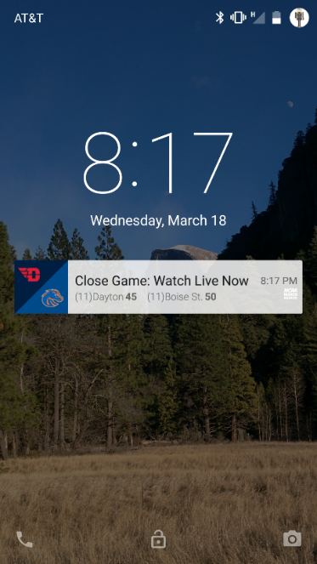
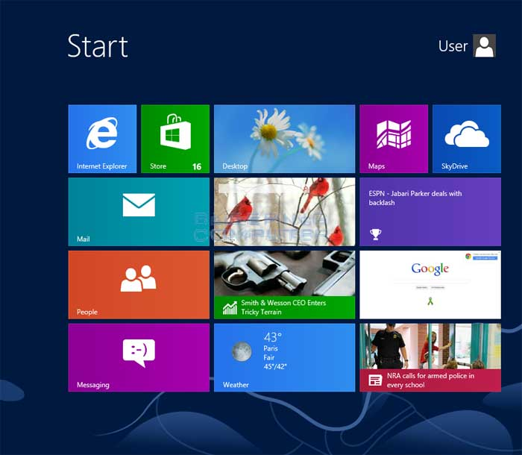
Different types of Notifications
Windows WNS
Toast
Tile
Badge
Raw
Windows Phone (MPNS)
Toast
Tile
Raw
Apple
Google
Amazon
Baidu
Notes:
What are Push Notifications?
Smartphones and tablets are able to "notify" users when an event has occurred. On Windows Store and Windows Phone applications, the notification results in a toast (a modeless window appearing at the top of the screen) or with tile updates on the Start screen. Similarly, on Android and Apple iOS devices, notifications appear grouped in a notification panel easily accessible from the top of the screen.
Push notifications help app back-ends display fresh information on mobile devices even when the app on the device is not active.

Slide 25

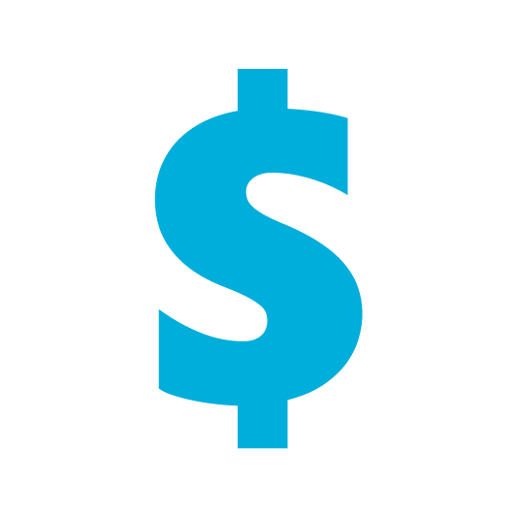



Mobile Push Is Everywhere
Breaking news
News/Media
SMS replacement, Deals, Back-office
Banking/Insurance
Prescriptions, Appointments,
LOB (maintenance)
Healthcare
Reservation changes, Deals, Back-office
Travel/Hospitality/Airlines
Orders, Product UX,
Back-office
Discrete manufacturing/Auto
Offers, Orders, Back-office
Retail
Notes:
Usage in different domain.
For example:
Send breaking news notifications to millions with low latency (Notification Hubs powers Bing applications pre-installed on all Windows and Windows Phone devices).
Send location-based coupons to user segments.
Send event notifications to users or groups for sports/finance/games applications.
Notify users of enterprise events like new messages/emails, and sales leads.
Send one-time-passwords required for multi-factor authentication.

Slide 26
Push Notification Lifecycle
Registration at app launch
Client app contacts Platform Notification Service, to retrieve current channel. App updates handle in back-end
Sending Notification
App back-end send notification to PNS
PNS pushes the notification to the app on the device
Maintenance
Delete expired handles when PNS rejects them
Platform
Notification
Service
App back-end
Notes:
Push Notification lifecycle in 3 points :
Registration
Send notification
Maintenance
This is the overview of how it works : the big picture to better understand how Notification Hub greatly help you.

Slide 27
Challenges of Push Notifications
Platform dependency
Different communication protocols to PNS
Different presentation formats and capabilities
Routing
Provide a way to send a message to a device/channel
Target user or group of interest
Back-end has to maintain an identification repository
Scale
Need to store current handles for each device
Broadcast to millions of devices with low latency
Notes:
Main point (in bold below)
Platform dependency
Need to interact with different system with no common standards (for example: HTTP vs TCP, xml payload vs. JSON payload)
Different presentation formats and capabilities depending on platform:(for example: Windows tiles vs. toasts vs. badges)
Routing
PNS’ provide a way to send a message to a device/channel
Usually notifications are targeted at users or interest groups (e.g. employees assigned to a customer account)
App back-end has to maintain a registry associating device handles to interest groups/users
Scale
App back-end has to store current handles for each device → high storage and VM costs
Broadcast to millions of devices with low latency requires parallelization (DB ad VM)

Slide 28
Using Notification Hubs
One-time set up
Create a Notification Hub
Register
Client app retrieves its current handle (PNS)
Client app registers on Notification Hub
Send Notification
App back-end sends a message to Notification Hub
Notification Hub pushes it to PNS’
iOS app
Windows app
MPNS
GCM
WNS
APNs
App back-end
ADM
Notification Hub
Notes:
Notification Hubs eliminate one major complexity: you do not have to manage the challenges of push notifications. Instead, you can use a Notification Hub. Notification Hubs use a full multiplatform, scaled-out push notification infrastructure, and considerably reduce the push-specific code that runs in the app backend. Notification Hubs implement all the functionality of a push infrastructure. Devices are only responsible for registering PNS handles, and the backend is responsible for sending platform-independent messages to users or interest groups, as shown in the following figure:
One-time set up
Create a Notification Hub
Register
The client app retrieves its current handle from the PNS
Client app creates (or updates) a registration on the Notification Hub with the current handle
Send Notification
The app back-end sends a message to the Notification Hub
Notification Hub pushes it to the PNS’
For more details: https://msdn.microsoft.com/en-us/library/azure/jj927170.aspx

Slide 29
Advantages of Using Notification Hubs
X-plat: from any back-end to any mobile platform
No need to store device information in the app back-end
Routing and interest groups
Personalization and localization
Broadcast at scale, multicast, unicast
Telemetry
Notes:
X-plat: from any back-end to any mobile platform
Backend can be on-premises or in the cloud, .NET/Node/Java/PHP/Node/anything.
Support Windows Phone/Windows/iOS/Android and (as of today) Kindle Fire.
No need to store device information in the app back-end
Notification Hub maintains the registry of devices and the associations to users/interest groups
Routing and interest groups
Target individual users and large interest groups using tags
Personalization and localization
Keep your back-end free of presentation concerns like localization and user preferences using templates
Broadcast at scale, multicast, unicast
Push notifications to millions of devices (across platforms) with a single call
Telemetry
Rich telemetry available through portal or APIs

Slide 30
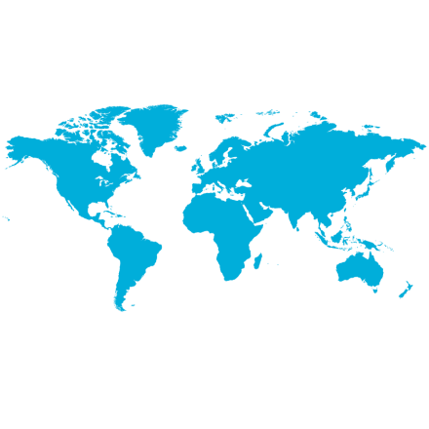
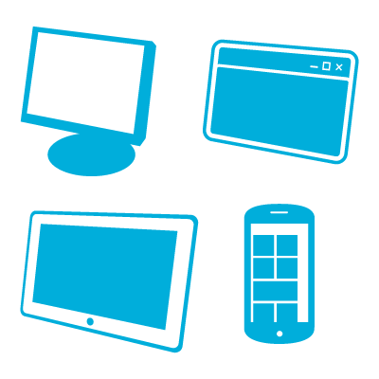
Case Studies
Past event sample
Bing (news, finance, sports, …)
Preinstalled on Windows
Millions of devices
Interest groups
(countries, disciplines, athletes)
Localized notifications
10s
100s
Millions of notifications/day
Minutes to delivery
Million devices
(iOS, Android, WP)
Million notifications
3+
<2
3+
150+
Notes:
Main points:
Bing application (Windows 8,8.1/10) : Bing New, Travel….
Sochi 2014 : real world scenario with massive load…

Slide 31
Demo: Get Started
Notes:
Getting started with Notification Hubs for Windows Store Apps
Prerequisites : An active Windows Store account
Demo:
Register your app for the Windows Store
Configure your notification hub
Connect your app to the notification hub
Send notifications
Full online script:
https://azure.microsoft.com/en-us/documentation/articles/notification-hubs-windows-store-dotnet-get-started/

Slide 32
Steps to Create Your Windows 10 to Send/Receive Notifications
Step 1- Register a new app in the Windows Dev Store and enable Push notification for this app (retrieve MPNS SSID & secret)
Step 2- Create your app in Visual studio and associate it with the store
Step 3- Create an Azure Notification hub service and enter your MPNS SSID & secret
Step 4- In Visual Studio, add WindowsAzure.Messaging.Managed nuget package. Develop your app.
Notes:
Step 1 :
Register a new app in the Windows Dev Store and enable Push notification for this app (retrieve MPNS SSID & secret)
Step 2
Create your app in Visual studio and associate it with the store
Step 3
Create an Azure Notification hub service and enter your MPNS SSID & secret
Step 4
In VisualStudio, add WindowsAzure.Messaging.Managed nuget package. Develop your app.
Complete instructions for all platforms: https://azure.microsoft.com/en-us/documentation/articles/notification-hubs-windows-store-dotnet-get-started

Slide 33

Basic Windows 10 App For Sending Notifications
Register your device at application startup

Slide 34

Basic Windows 10 App For Sending Notifications
Send a notification from your back-end:

Slide 35
Code Snippets
Send
Register
Windows / Windows Phone
await hub.RegisterNativeAsync(channel.Uri);
.NET
var toast = @"<notification payload>";
hub.SendWindowsNativeNotificationAsync(toast);
iOS
[hub registerNativeWithDeviceToken:deviceToken
tags:nil
completion:^(NSError* error) { … }];
Node / Mobile Services
hubService.wns.sendToastText01(null, { text1: 'Hello from Node!' }, function (error) { … }
);
Android / Kindle
hub.register(regid);

Slide 36
Send Targeted Notifications

Slide 37
Tags
Tags as interest groups
Client app can register with a set of tags
Tags are simple strings (no pre-provisioning is required)
App back-end can target all clients with the same tag
You can use tags also for:
Multiple type of interest groups, for example:
Follow bands: tag “followband:Beatles”
Follow users: tag “followuser:Alice”
Tag devices with a user ID
Tags can be user preferences or system information
App back-end
Tag:”Beatles”
Notification Hub
Tag:”Wailers”
Tag:”Beatles”
Notes:
A tag can be any string, up to 120 characters, containing alphanumeric and the following non-alphanumeric characters: ‘_’, ‘@’, ‘#’, ‘.’, ‘:’, ‘-’. The following example shows an application from which you can receive toast notifications about specific music groups. In this scenario, a simple way to route notifications is to label registrations with tags that represent the different bands, as in the following picture.
In this picture, the message tagged Beatles reaches only the tablet that registered with the tag Beatles.
For more information about creating registrations for tags, see Registration Management.
You can send notifications to tags using the send notifications methods of the Microsoft.ServiceBus.Notifications.NotificationHubClient class in the SDK. You can also use Node.js, or the Push Notifications REST APIs.
Note the following examples:
C# : await hub.SendWindowsNativeNotificationAsync(wnsToast, "tag");
Note: Tags do not have to be pre-provisioned and can refer to multiple app-specific concepts. For example, users of this example application can comment on bands and want to receive toasts, not only for the comments on their favorite bands, but also for all comments from their friends, regardless of the band on which they are commenting. The following picture shows an example of this scenario:
For more details: https://msdn.microsoft.com/en-us/library/azure/dn530749.aspx?cs-save-lang=1&cs-lang=csharp#code-snippet-1

Slide 38
Some Snippets
Register
Windows / Windows Phone
await hub.RegisterNativeAsync(channel.Uri, new string[] {"myTag", "myOtherTag"});
iOS
[hub registerNativeWithDeviceToken:deviceToken tags:@[@"myTag", @"myOtherTag"] completion:
^(NSError* error) {
…
}];
Android / Kindle
hub.register(regid, "myTag“, "myOtherTag");

Slide 39


